Slide 1
Running AlphaFold2 at Vanderbilt
Jarrod A. Smith, Ph.D. jarrod.smith@vanderbilt.edu

Slide 2
Outline
How to get AlphaFold Software
Available Methods to Run AlphaFold
Google Colab
Docker
Running AlphaFold outside of Docker
Running AlphaFold at ACCRE

Slide 3
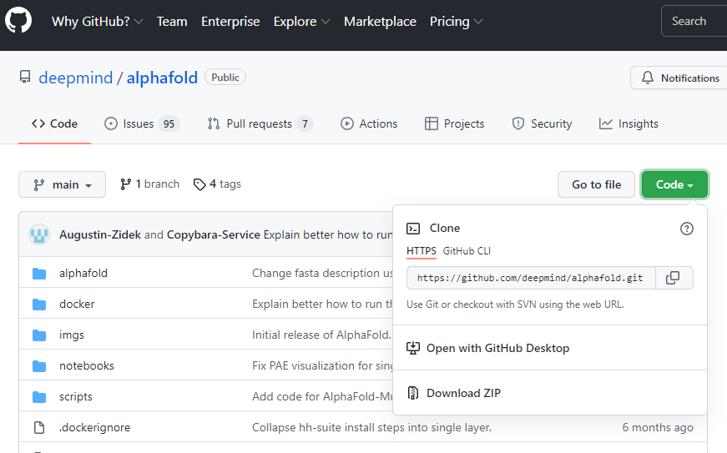
AlphaFold Software Distribution
http://github.com/deepmind/alphafold

Slide 4
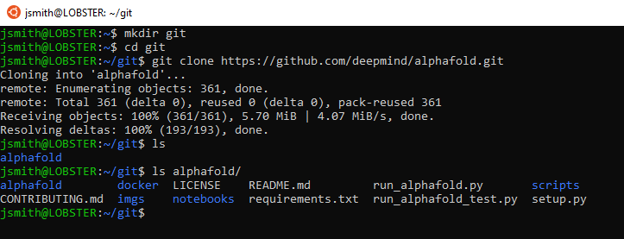
Download AlphaFold with git CLI
Windows: Git Bash
https://gitforwindows.org/
Linux
% sudo yum install git git-lfs (CentOS/RHEL)
% sudo apt install git git-lfs (Debian/Ubuntu)

Slide 5
What Does AlphaFold Require?
AlphaFold is a Python application that depends upon a large number of other Python applications/libraries
The main prediction code utilizes machine learning routines that benefit from GPU accelerators
Ideally you should have a modern NVIDIA GPU in your system, with plenty of GPU memory (12GB+) and a kernel driver and libraries that support CUDA 11.0 or newer
The code requires access to a series of sequence/structure databases and model parameters that you must download. This requires >2TB of free disk space
Ideally this is on fast storage (SSDs) local to your computer

Slide 6
Available Methods to Run AlphaFold
Google Colab
Pros: Browser-based, easiest, free
Con: Limited # of predictions, limited accuracy, limited size
Local Docker
Pros: Full accuracy predictions, support/easy updates
Cons: Requires Docker and 2.2TB of data to be installed, $$
Local non-Docker methods (e.g. Miniconda)
Pros: Maximum flexibility, good for developing/tweaking
Cons: Harder to install, no support, $$
ACCRE/Bluefin clusters
Pros: Installed/supported by CSB, economical
Cons: Requires cluster account(s) and tool knowledge

Slide 7
AlphaFold Colab
https://colab.research.google.com/github/deepmind/alphafold/blob/main/notebooks/AlphaFold.ipynb
Simplified version of AlphaFold
No homologous structures are used
Significantly abbreviated version of the BFD sequence cluster database is used
Leads to reduction in accuracy. Significant for some targets, small for others.
Runs on Google’s Colab (Cloud) platform
Colab notebooks are Jupyter notebooks running on GCP
12-16GB T4 and P100 GPUs
Jupyter is software that makes it easy to develop and share Python applications via the web.

Slide 8
AlphaFold Colab (cont)
To run the application, click through the play buttons

Slide 9
AlphaFold Colab (cont)
This 72AA example took ~42min to run. About 22 min for the MSA and 20 min for the prediction. Increasing size increases runtime and requires more GPU memory.

Slide 10
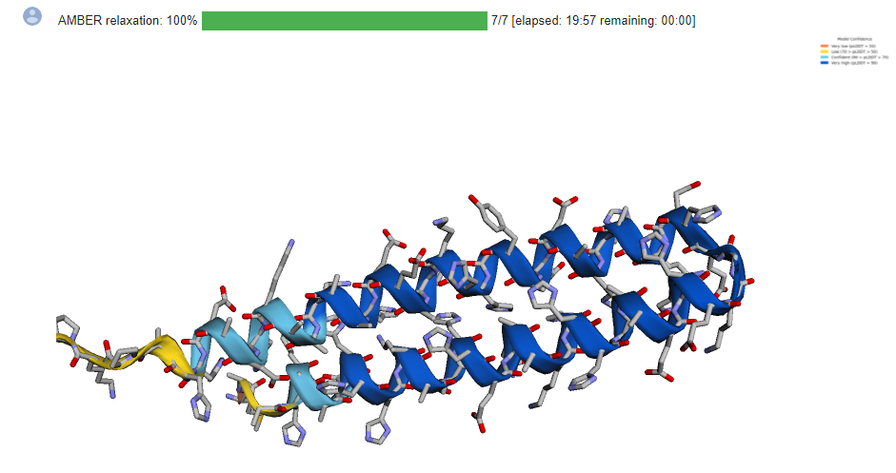
AlphaFold Colab (cont)

Slide 11
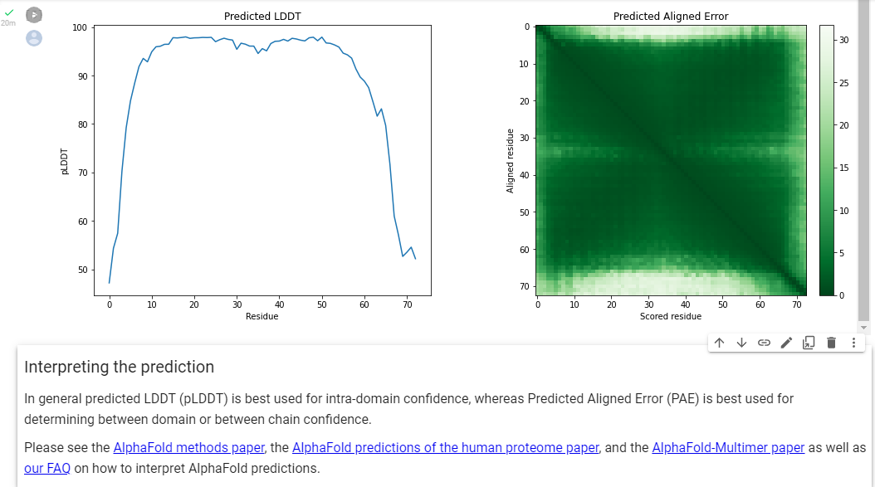
AlphaFold Colab (cont)
As you can see, it is trivial to setup and run AlphaFold via this Colab, so it is a good option to get up and running quickly. However, the code and databases are dumbed down from the published version and the free version provides no guarantee that they won’t fail or time out due to resource or time limits (12h max).

Slide 12
Running AlphaFold in a Local Docker Instance
A Docker container is the primary way that AlphaFold authors support the application for running on local resources
Containers are a convenient “virtualized” method to distribute a software application along with all its dependencies
Docker requires a host UNIX/Linux kernel
Linux workstation
Linux virtual machine (e.g. Virtual Box or Vmware)
Mac OSX
WSL2 on Windows
http://www.docker.io http://docs.docker.com/engine/install/

Slide 13
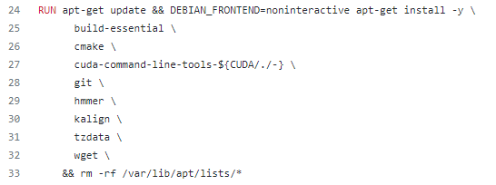
AlphaFold in a Docker Instance (cont)
Docker containers are built from a Docker File, which is effectively a script that follows a specific syntax https://github.com/deepmind/alphafold/blob/main/docker/Dockerfile

Slide 14
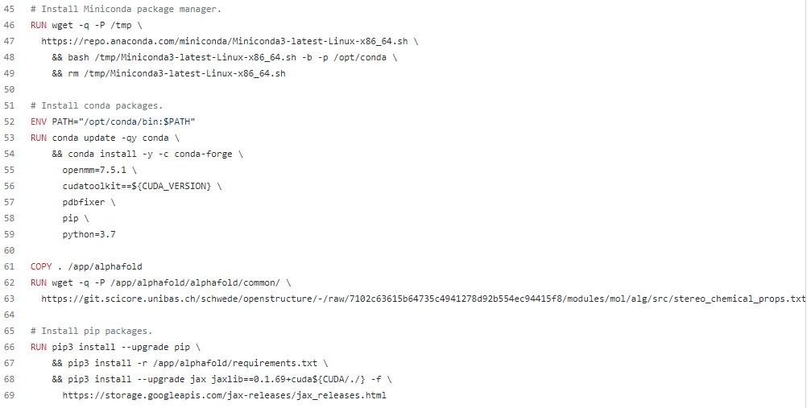
AlphaFold in a Docker Instance (cont)

Slide 15
AlphaFold in a Docker Instance (cont)
Install python3
Install Docker
Install NVIDIA Container Toolkit
Download DBs/Params (scripts/download_all_data.sh)
% docker build –f docker/Dockerfile –t alphafold .
% pip3 install –r docker/requirements.txt
% python3 docker/run_docker.py <arguments>

Slide 16
Local Miniconda Install
Docker is typically not available on HPC systems, so here we are supporting AlphaFold outside of Docker
Miniconda is a system to install and manage python dependencies for multiple applications to avoid incompatibilities
We can read the Docker file and replicate those functionalities in a Miniconda environment that will run on our workstations and HPC clusters
install-miniconda-af211.sh

Slide 17
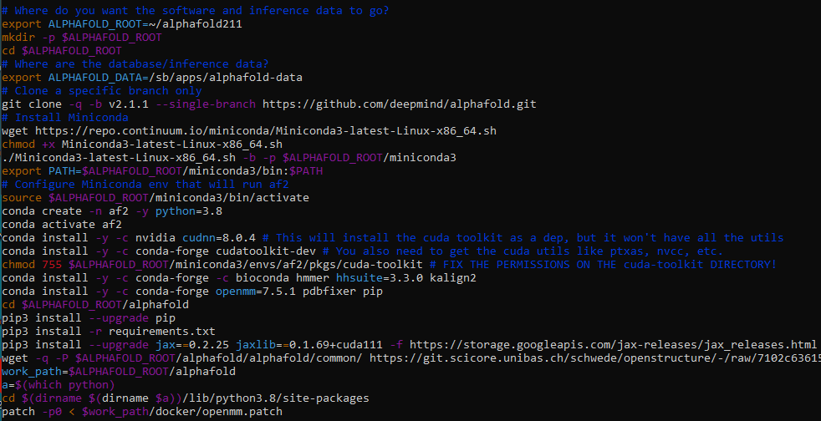
Local Miniconda Install (cont)

Slide 18
ACCRE/Bluefin/CSB Workstations (Miniconda)
I’ve used this script to install a shared AlphaFold 2.1.1 environment for use on CSB workstations and the ACCRE and bluefin clusters
/sb/apps/alphafold211/Miniconda3
/sb/apps/aphafold211/alphafold
/sb/apps/alphafold-data
/csbtmp/alphafold-data on Turing GPU nodes at ACCRE
Example scripts using this environment are available
/sb/apps/alphafold211/scripts/run_alphafold_ACCRE_Turing.sb
/sb/apps/alphafold211/scripts/run_alphafold_bluefin.sb
/sb/apps/alphafold211/scripts/run_alphafold_ws.sb

Slide 19
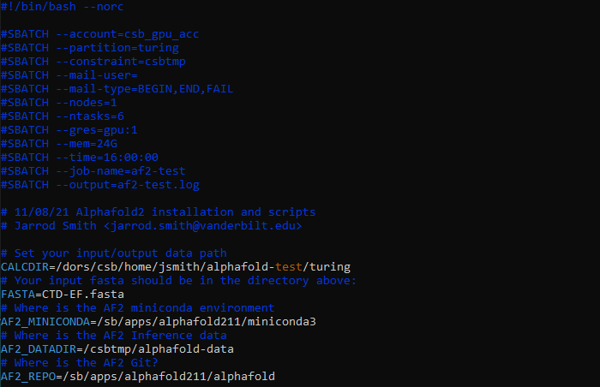
run_alphafold_ACCRE_Turing.sb

Slide 20
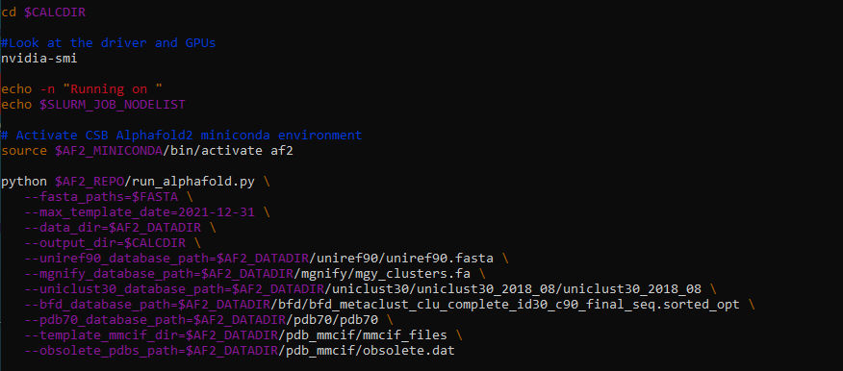
run_alphafold_ACCRE_Turing.sb (cont)

Slide 21
ACCRE/Bluefin (Singularity)
Docker is not typically supported in HPC environments, because it requires users to be in a group with elevated privileges
Singularity is an HPC-friendly container platform
https://www.vanderbilt.edu/accre/documentation/singularity
WIP: Singularity container for running AlphaFold at ACCRE
Currently under development by Sai Medury and myself
/sb/apps/alphafold211/singularity/alphafold.sif
/sb/apps/alphafold211/scripts/run_alphafold_ACCRE_singularity.sb

Slide 22
Questions?
jarrod.smith@vanderbilt.edu Download this presentation and the example scripts at:
http://csb.vanderbilt.edu/workshops/alphafold/running_alphafold.tar.gz

