Slide 1
What is an assignment?
Associate a given signal back to the originating spin

Slide 2
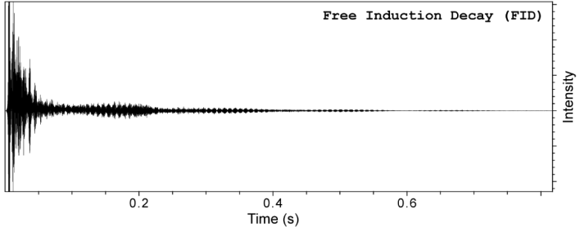
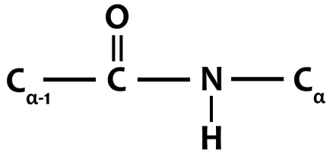
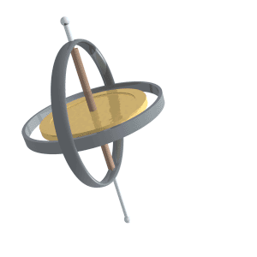
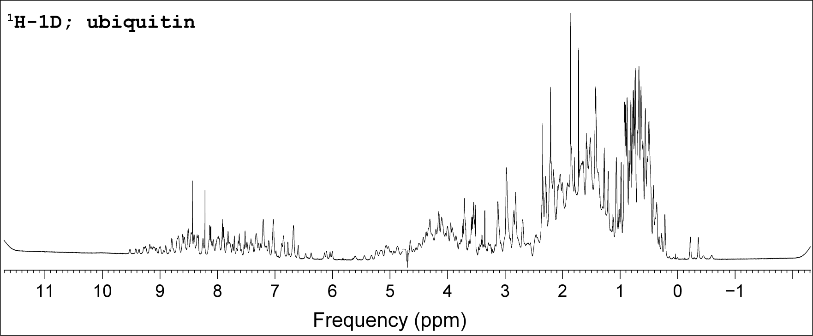
Every atom with spin has a Larmor frequency
‘X’ Hz
Fourier Transform (FT)
Time → Frequency
$$δ (ppm)= \frac{(ν_{S}−ν_{R}) }{ν_{R}}×{10}^{6}$$
‘Y’ Hz
Assignments!
This frequency is a physical property of that atom – it is the same value no matter what experiment is run!

Slide 3
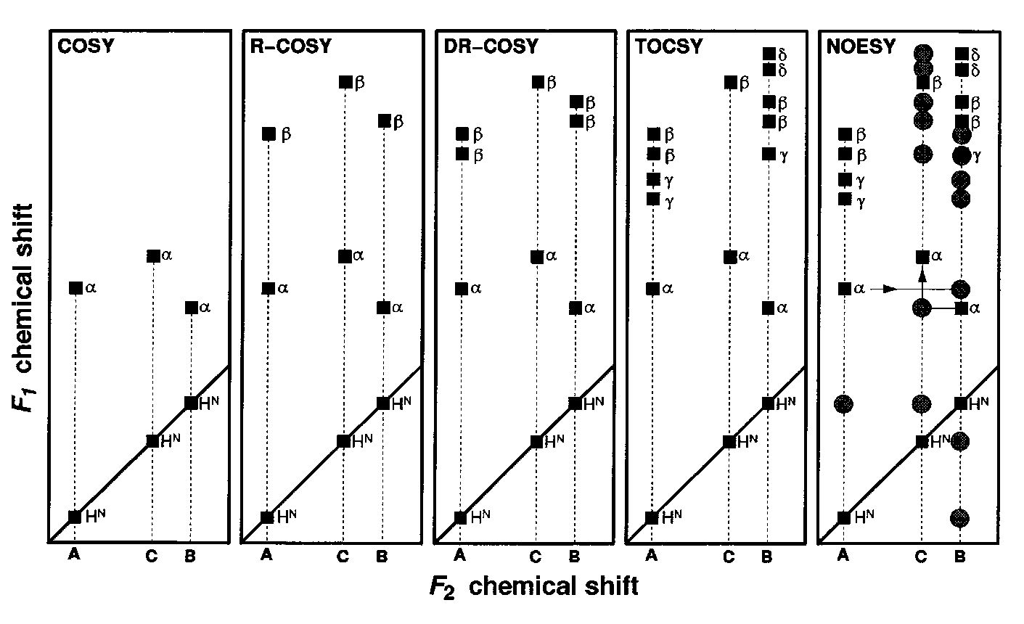
Homonuclear 2D Expts

Slide 4
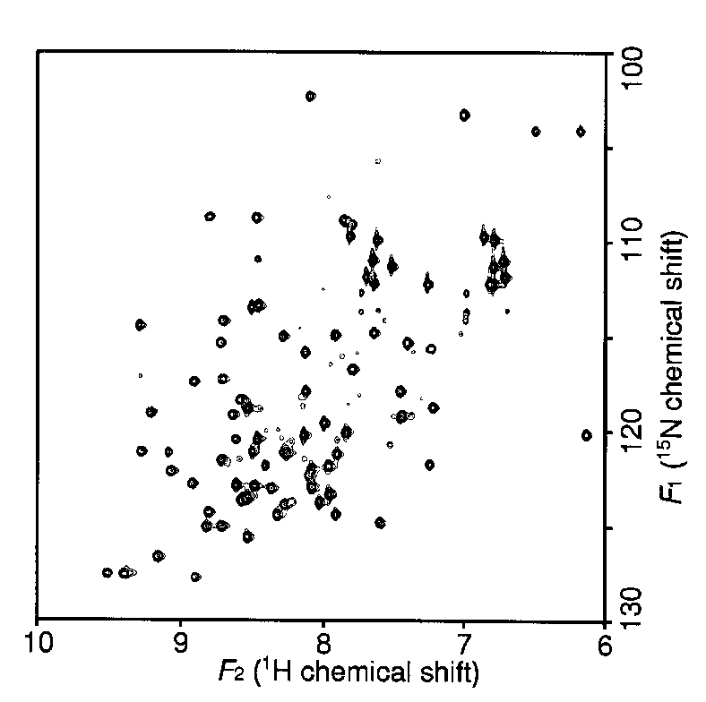
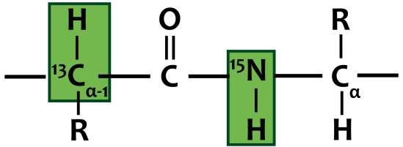
Double-Resonance Experiments Increases Resolution/Information Content
¹⁵N-¹H HSQC

Slide 5
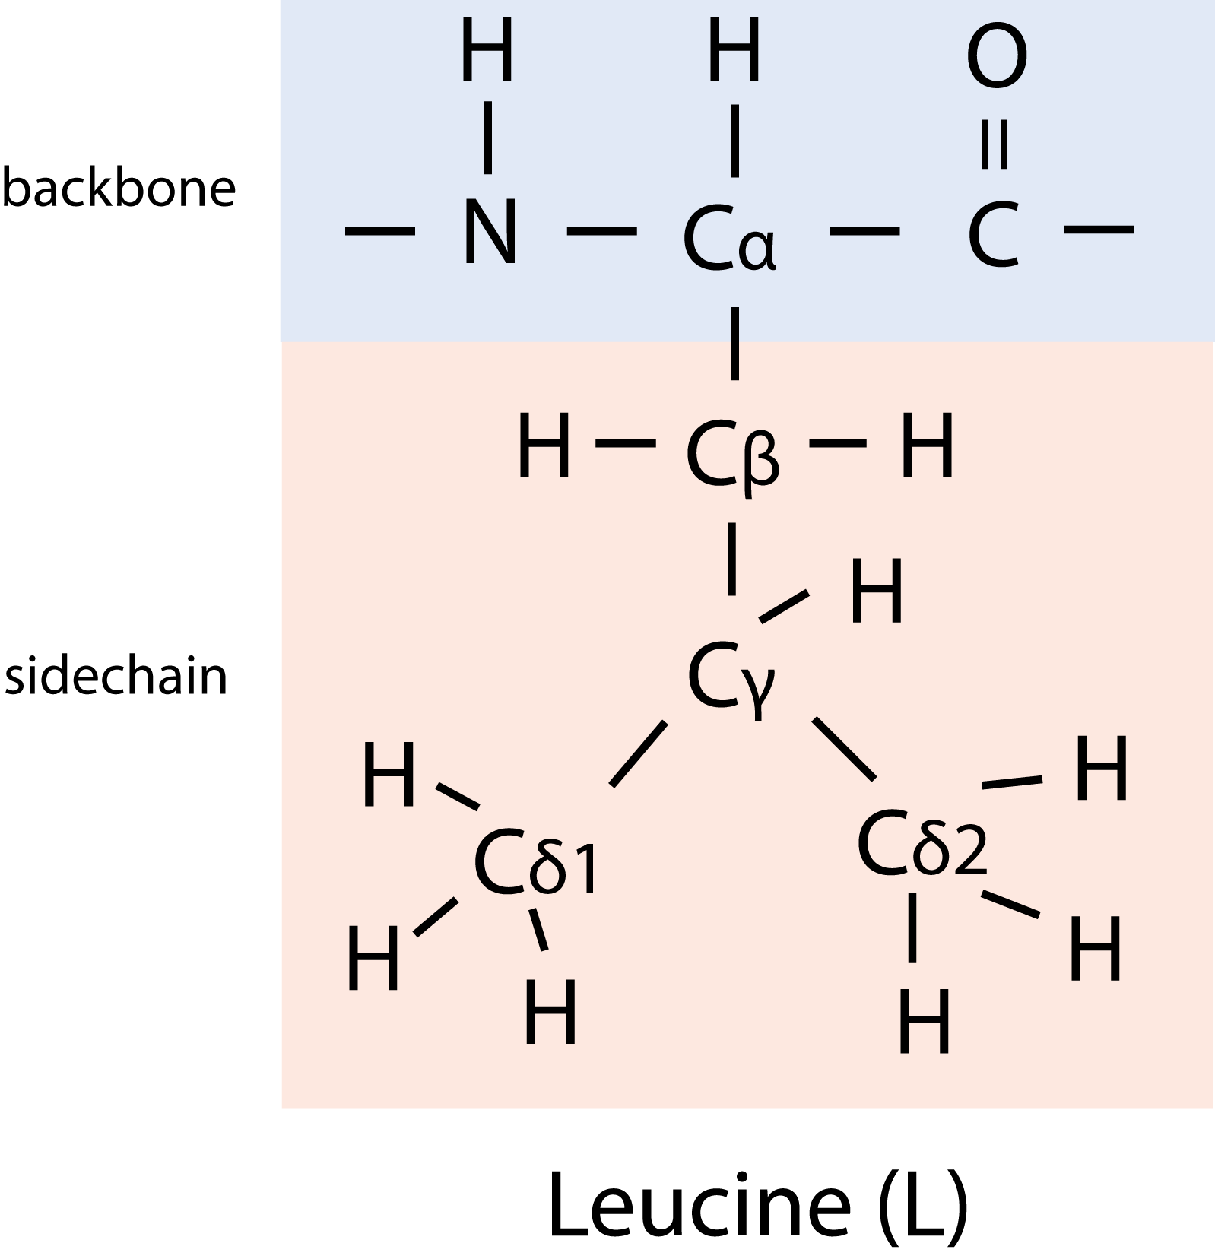
Basic Strategy to Assign Resonances
Identify resonances for each residue (scalar)
Put residues in order
T
L
S
R
G
S
G
1 2 3 4 5 6 7
R - G - S - T - L - G - S

Slide 6
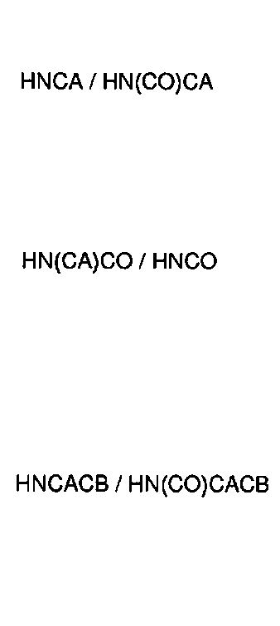
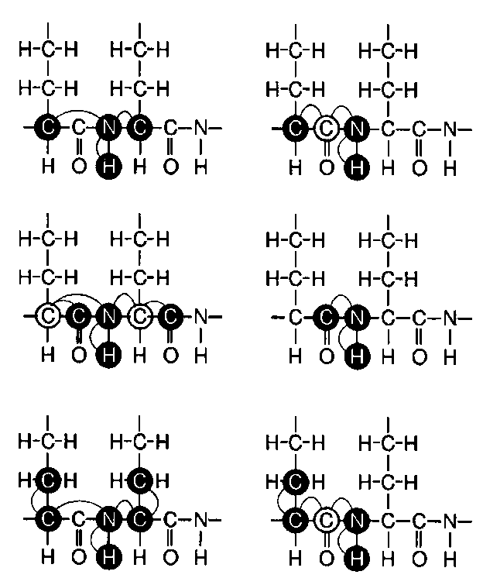
Heteronuclear Triple-Resonance Backbone Experiments
Names of scalar experiments based on atoms detected

Slide 7
Topics for today:
Sequential walking
Mapping spin systems to the protein sequence
Choosing the right triple resonance experiment
Tricks for resolving challenging systems
(What to do when the CBCACONH doesn’t cut it!)
Translating assignments to a protein complex
Software packages for spectra visualization
Basic primer of the hands-on tutorial
Using the software: the assignment process demo

Slide 8
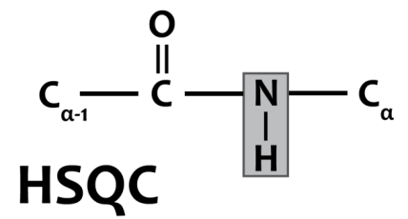
Protein Backbone Assignment
C
A
¹⁵N
B
¹H

Slide 9
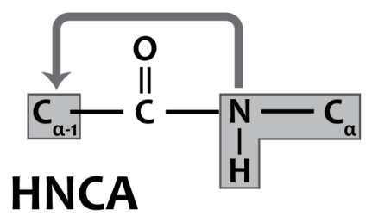
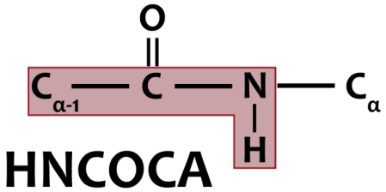
Connecting Spin Systems
¹H
B
¹⁵N
A
C
¹³C
B→A→C

Slide 10
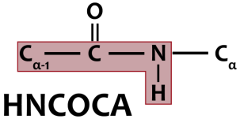
Strip Matching View
Pseudo-
Residue:
C
D
E
F
G
H
I
¹³C
¹H
¹⁵N

Slide 11
Turning Pseudo-residues to Assignments
Problem:
Need a to convert strips to sequence
Solution:
Determine amino acid identity
Compare to known protein sequence

Slide 13
Unique spins of some residue types
Alanine
High alpha (52)
Unique beta (19)
Glycine
Unique alpha (45)
No beta
Proline
No direct signal (no HN)
Can still observe (i-1) signal
Serine/Threonine
Unique betas (63/69)
Asparagine/Aspartate
High alpha & Low beta
Isoleucine
Low alpha and low beta
Valine
Low alpha and high beta

Slide 14
Example Assignment
RERRIHVTQEDFELAVGKVMNKNQETAISVAKLFK

Slide 15
All Spins Need to “Walk”
Cross-validate assignments – all spin types will walk if assignments are correct!
Redundant data is safer!

Slide 16
Techniques to interpret tricky assignments

Slide 17
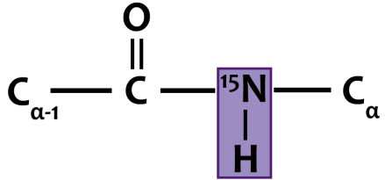
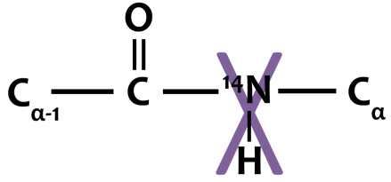
Selective Amino Acid Labeling
1 type
19 types
Create selectively labeled sample
Acquire HSQC/TROSY
Identify spin systems of labeled type

Slide 18
Secondary Structure Influences Chemical Environment

Slide 19
Secondary Structure Influences Carbon Chemical Shifts
$$CSI = δ_{Avg.}−δ_{Obs.}$$
↑ : β-strand
‒ : unstructured
↓ : α-helix
If secondary structure is known (i.e. homology model or structure), one can anticipate shifting from the literature random coil value.

Slide 20
Moving back to Homonuclear
¹⁵N-dispersed 3D homonuclear expts – relates side chains to amides
¹⁵N-NOESY has signals unique to 2° - useful for linking pseudo-residues in a helix
i.e. α-helicies have i to i+3/i+4 NOE’s
¹⁵N-TOCSY or NOESY shows number of hydrogens in a side chain – useful for amino acid type identity

Slide 21
Practical Considerations
The best way to get good assignments it to collect good data!

Slide 22
Sample Preparation
Target 400-600 μM concentration
2x conc = 4x sensitivity
¹⁵N-¹³C labeled (~90% ²H preferred)
Deuterium slows relaxation, more signal
Stable for ~4-6 days in acquisition buffer
Minimal precipitation/aggregation
Sometimes concentration dependent
Hydrated in water-based buffers (not D₂O or organics) to have signal.
Salt below 100 mM to take advantage of cryoprobe sensitivity

Slide 23
Spectra Sensitivity
Approximate relative sensitivity:
HNCO
HNCOCA
HNCA
HNCACB
HNCACO
CBCACONH
Non-Uniform sampling (acquire ~25% of points)
CACB pair gives most data/connectivities, but is least sensitive.
CA pair is generally more useful than CO pair for connectivities
More sensitive
Less sensitive

Slide 24
Spectral Resolution
HNCO good for determining if H-N peaks are overlapped.
HNCA has better resolution than HNCACB, good dispersion and smaller frequency range

Slide 25
Choosing what spectra to acquire
Know what assignments you need:
Assign HSQC, full backbone, or complete assignment?
Always start and end acquisition with a ¹⁵N-HSQC
Checks for protein folding/degradation & sensitivity changes
H-C plane projections (set ¹⁵N resolution to 1)
Quick way to see if there is good enough sensitivity before 3D
Always test CACB sensitivity first – usually preferred if good sample

Slide 26
Assignment of a Protein Complex

Slide 27
Assignments of a Protein-ligand Complex
Sometimes free and bound spectra are significantly different:
Re-assign backbone with triple resonance
Translate spin system assignments from free to bound state using amides as a proxy

Slide 28
Interactions: Equilibrium time scale
K_{eq}
slow
intermediate
fast
δ_{A}
δ_{B}
[A] ≈ [B]

Slide 29
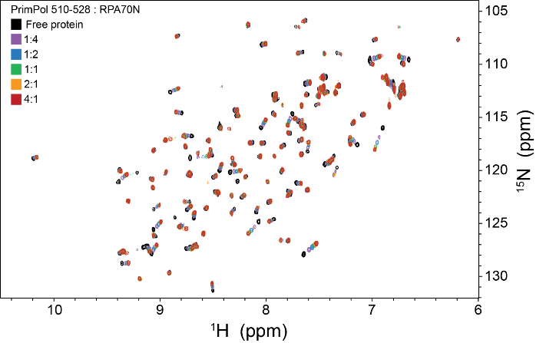
Interactions: Fast Exchange
K_{eq}
slow
intermediate
fast
δ_{A}
δ_{B}
[A] ≈ [B]

Slide 30
Interactions: Slow Exchange
K_{eq}
slow
intermediate
fast
δ_{A}
δ_{B}
[A] ≈ [B]

Slide 31
ZZ-Exchange correlations
Tight interactions (nM dissociation)
Subsaturating ligand creates two states in slow exchange
Translate assignment from free state to bound state by identifying cross peaks

Slide 32
Intro to the Assignment Tutorial

Slide 33
The Ubiquitin Proteasome System

Slide 34
Introduction to Ubiquitin
MQIFVKTLTGKTITLEVEPSDTIENVKAKIQDKEGIPPD QQRLIFAGKQLEDGRTLSDYNIQKESTLHLVLRLRGG
76 amino acids
~8.5 kDa
Strong/dispersed signal

Slide 35
What are we doing next class?
Pair into groups of two – meet here to start class
Find a workstation
Assign the backbone of ubiquitin
15N-HSQC
CBCACONH
HNCACB
Learn visualization software

Slide 36
Visualization Software
Sparky
NMR ViewJ
XEASY
CARA
CCPNMR

Slide 37
The Complete Assignment Process
View HSQC
Generate (pick) peaks on HN correlations
Look into carbon plane for each given H and N ppm
Pick peaks for each carbon resonance
Use overlays to determine i and i-1
Sequential walking
Amino acid type identification
Map strip series to sequence
Verify assignments with every acquired spectrum
Determine side chain assignments, if necessary.

Slide 38
Demonstration

