Slide 1
Why do we care about biomolecules?

Slide 2
Why do we use NMR?

Slide 3
Q: How do we take a spectrum and derive structure and function from it?
A: Take signal features, and relate them back to the originating spin

Slide 4
What is an assignment?
Associate a given signal/frequency back to the originating spin

Slide 5
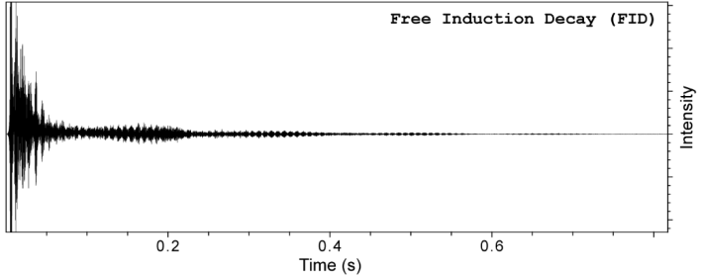
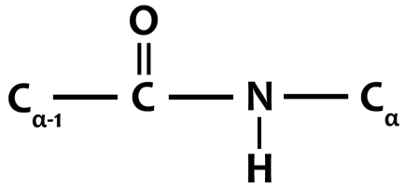
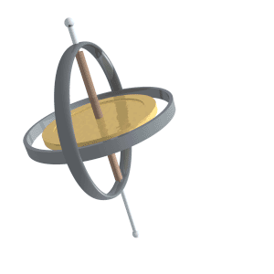
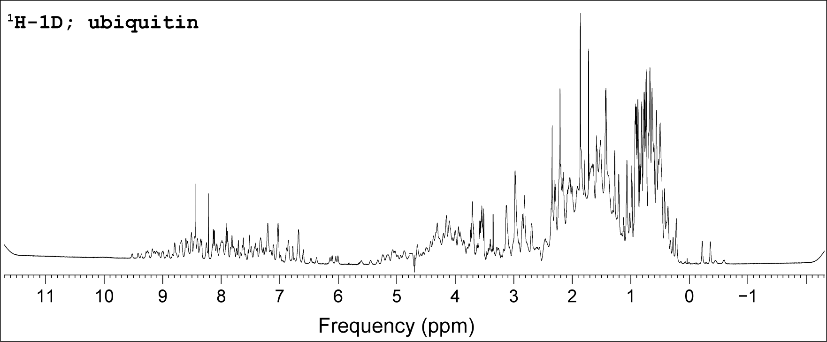
Every atom with spin has a Larmor frequency
‘X’ Hz
Fourier Transform (FT)
Time → Frequency
$$δ (ppm)= \frac{(ν_{S}−ν_{R}) }{ν_{R}}×{10}^{6}$$
‘Y’ Hz
Assignments!
This frequency is a physical property of that atom – it is the same value no matter what experiment is run!

Slide 6
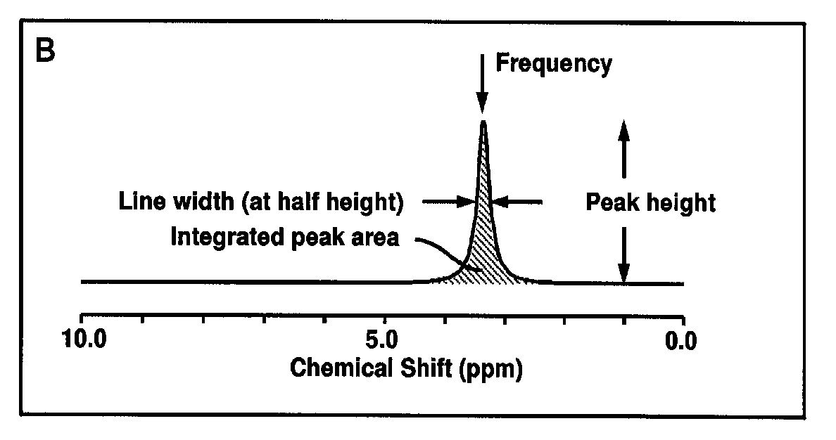
Unique features of each signal Chemical Shift & Linewidth
The exact resonance frequency (chemical shift) is determined
by the electronic environment of the nucleus

Slide 7
Critical features influence spin frequencies
Spins start at a given frequency based on its gyromagnetic ratio
Local chemical bonds influence resonance frequency
Sample solvent conditions influence frequency
Tertiary structure leads to increased dispersion of resonances.
Ligand binding changes spin properties
Every atom in a protein is chemically unique, thus
every atom has a unique assignment!

Slide 8
Each atom has a unique chemical environment

Slide 9
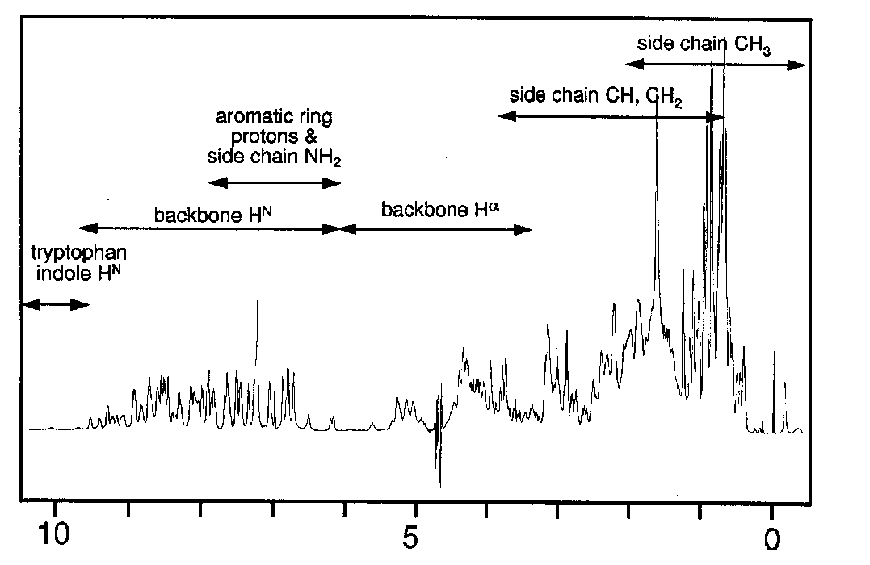
Regions of the ¹H NMR Spectrum
What would the unfolded protein look like?

Slide 10
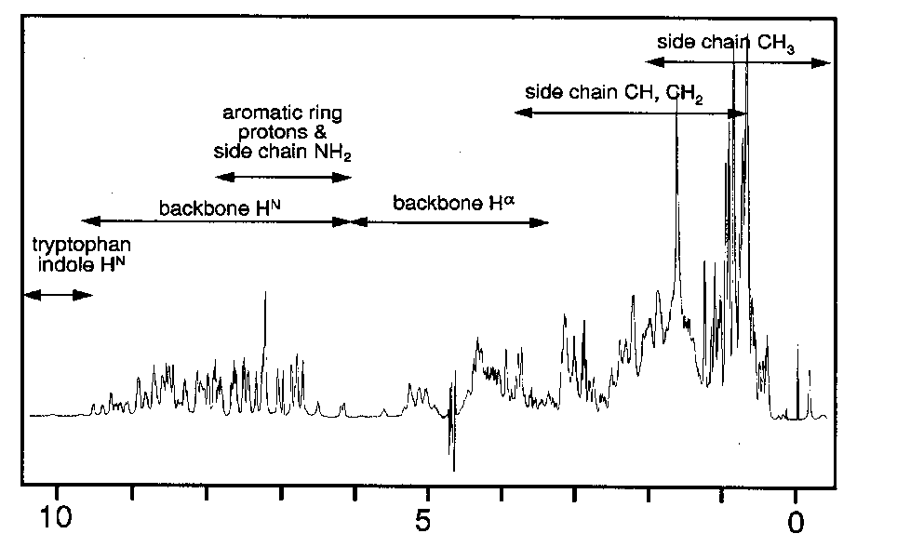
Proteins Have Too Many Signals! ¹H NMR Spectrum of Ubiquitin
~500 resonances
Resolve resonances by multi-dimensional experiments

Slide 11
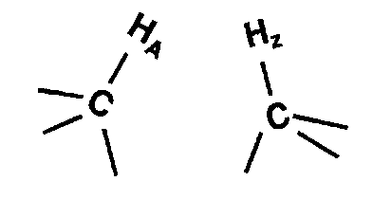
Solutions to the Challenges of Too Many Signals
Increase dimensionality of spectra to better resolve signals: 1→2→3 →4
Higher dimensions link spins to one other
t2
t1
t3

Slide 12
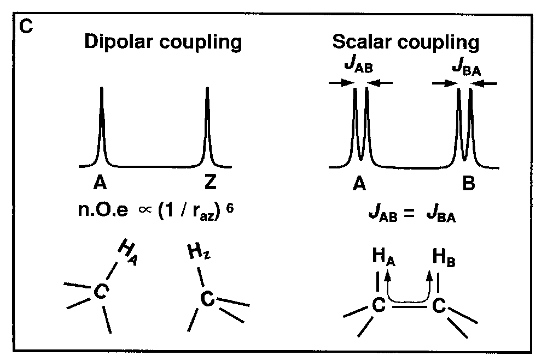
Scalar and Dipolar Coupling
Through
Space
Through
Bonds
Coupling of nuclei gives information on structure

Slide 13
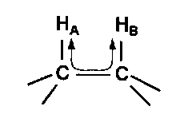
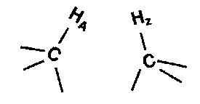
2D NMR: Coupling is the Key
Transfers magnetization between coupled spins
90° pulse
Same as 1D experiment
t1
t2
t1
t2

Slide 14
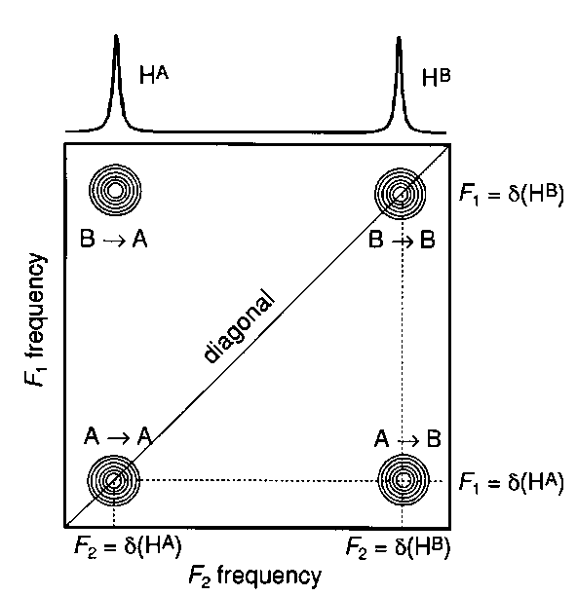
The 2D NMR Spectrum
Pulse Sequence
t1
t2
Spectrum
Before mixing
Coupled spins
After mixing

Slide 15
The Power of 2D NMR: Resolving Overlapping Signals
1D
2 signals
overlapped
2D
2 cross peaks
resolved

Slide 16
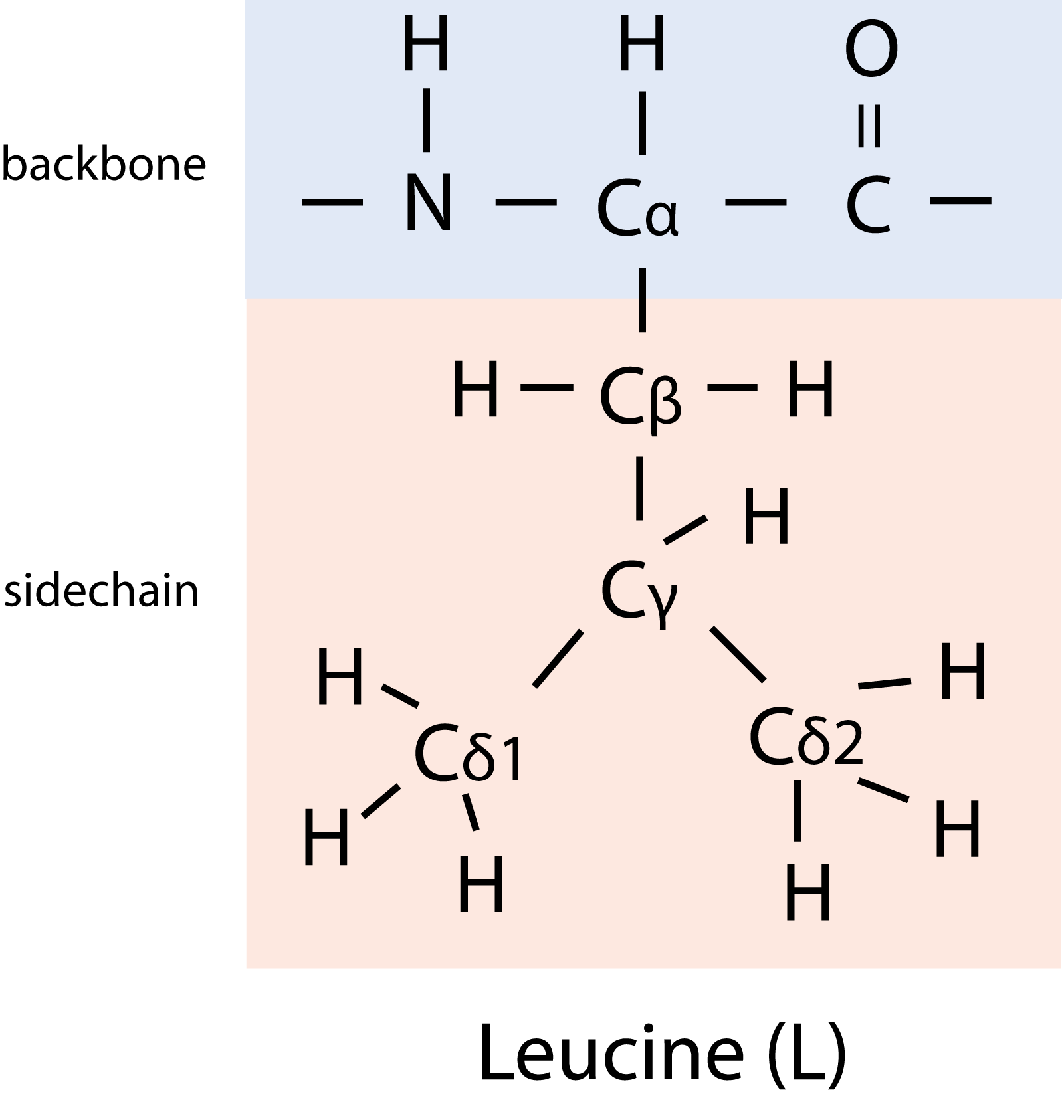
Basic Strategy to Assign Resonances
Identify resonances for each residue (scalar)
Put residues in order
T
L
S
R
G
S
G
1 2 3 4 5 6 7
R - G - S - T - L - G - S

Slide 17
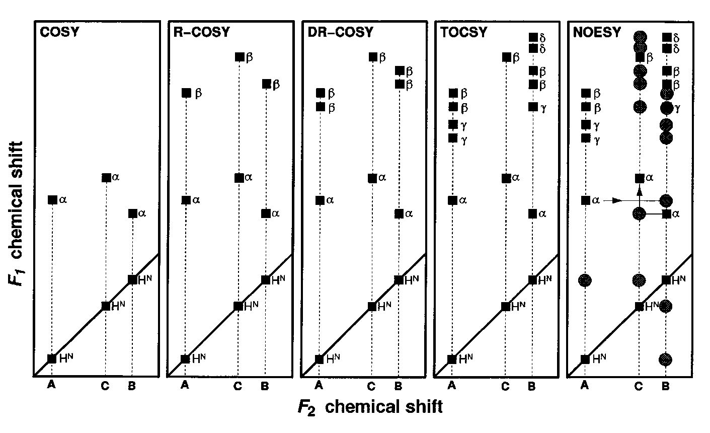
Homonuclear 2D Expts

Slide 18
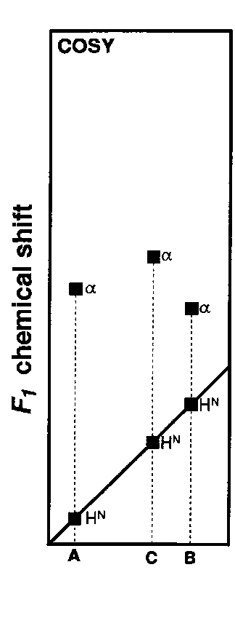
COSY: One coupling
H
H
A
N—C
H
H
B
N—C
H
H
C
N—C

Slide 19
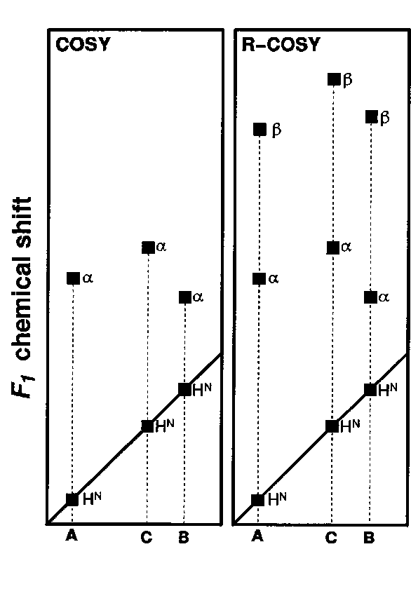
R-COSY: Add A 2nd Coupling
H
H
H
A
N—C—C
H
H
H
B
N—C—C
H
H
C
N—C—CH₃

Slide 20
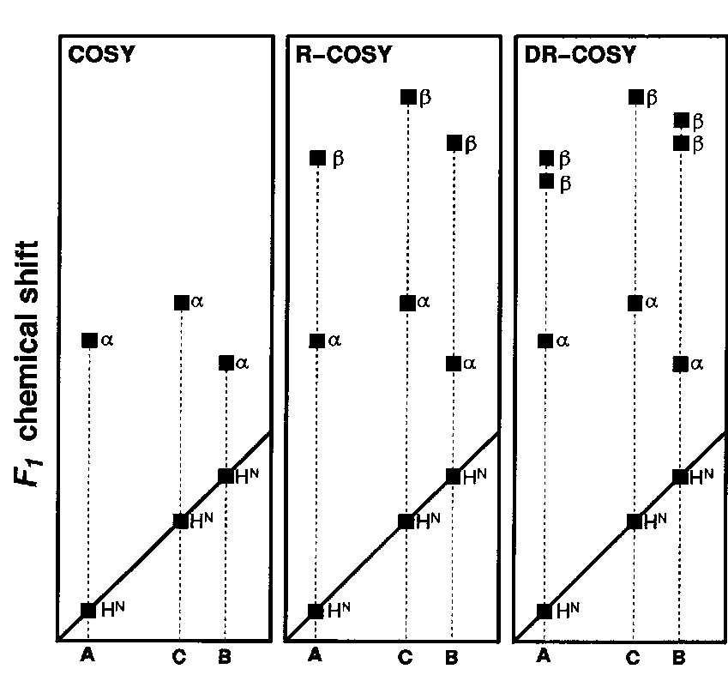
DR-COSY: Add A 3rd Coupling
H
H
H
A
N—C—C
H
H
H
H
B
N—C—C
H
H
H
C
N—C—CH₃

Slide 21
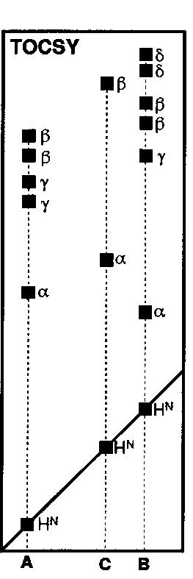
TOCSY: All Coupled Spins
H
H
H
H
A
N—C—C—C—COOH
H
H
H
H
H
H
H
H
B
N—C—C—C—C—C—NH₃
H
H
H
H
H
H
C
N—C—CH₃

Slide 22
Homonuclear 2D Expts

Slide 23
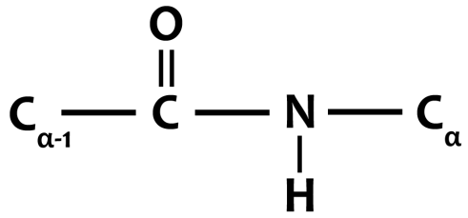
Limitations of Homonuclear NMR
Nuclei are not all mutually coupled
Each amino acid gives rise to an independent NMR sub-spectrum, which is much simpler than the complete protein spectrum

Slide 24
Basic Strategy to Assign Resonances
Identify resonances for each residue (scalar)
Put residues in order
T
L
S
R
G
S
G
1 2 3 4 5 6 7
R - G - S - T - L - G - S

Slide 25
Solutions to the Challenges
Most abundant nitrogens, carbons, and oxygens do not provide NMR-viable signal
Detect signals from heteronuclei (non-hydrogens)
Isotopically enrich protein sample with ¹³C, ¹⁵N, or ²H to overcome low natural abundance

Slide 26
Intrinsic Sensitivity of Nuclei
Nucleus γ % Natural Relative
Abundance Sensitivity
¹H 2.7 x 10⁸ 99.98 1.0
¹³C 6.7 x 10⁷ 1.11 0.004
¹⁵N -2.7 x 10⁷ 0.36 0.0004
³¹P 1.1 x 10⁸ 100 0.5
Prepare samples enriched in these nuclei

Slide 27
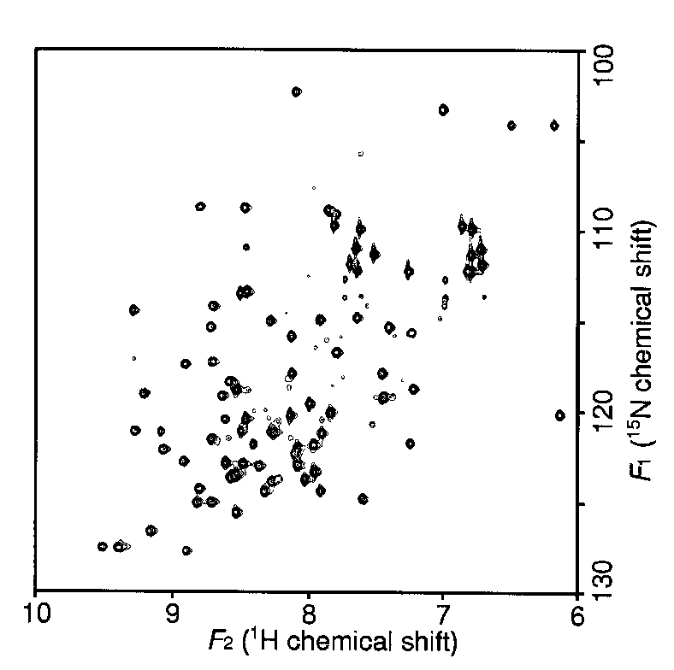
Double-Resonance Experiments Increases Resolution/Information Content
¹⁵N-¹H HSQC
R
R
-¹⁵N - C_{α}- CO -¹⁵N - C_{α}
H
H

Slide 28
Acronyms For Basic Experiments Differ Only By The Nature Of Mixing
Homonuclear
Heteronuclear
Scalar Coupling
COSY
HSQC
TOCSY
Hetero-TOCSY
Multiple
Quantum
HMQC
Dipolar Coupling
NOESY
NOESY-HSQC
NOESY-HMQC

Slide 29
Higher Dimensional NMR: Built on the 2D Principle
3D- detect signals 3 times
90º pulse
(t3)
t1
t2
Same as 1D experiment
t3
3D NMR Pulse Sequence

Slide 30
TOCSY: All Coupled Spins
H
H
H
H
A
N—C—C—C—COOH
H
H
H
H
H
H
H
H
B
N—C—C—C—C—C—NH₃
H
H
H
H
H
H
C
N—C—CH₃

Slide 31
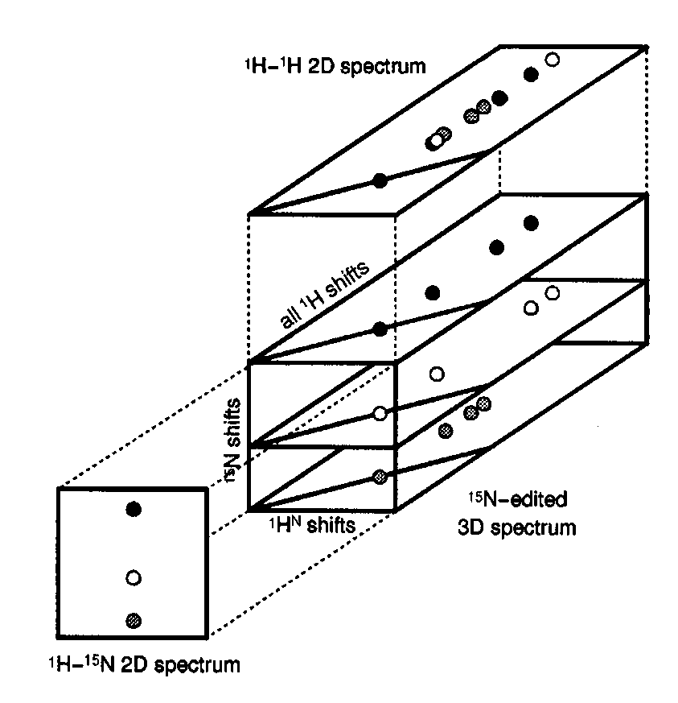
¹⁵N Dispersed ¹H-¹H TOCSY
3 overlapped NH resonances
Same NH, different ¹⁵N
F3
F2
TOCSY HSQC
F1
¹H ¹H ¹⁵N
t₃
t₂
t₁

Slide 32
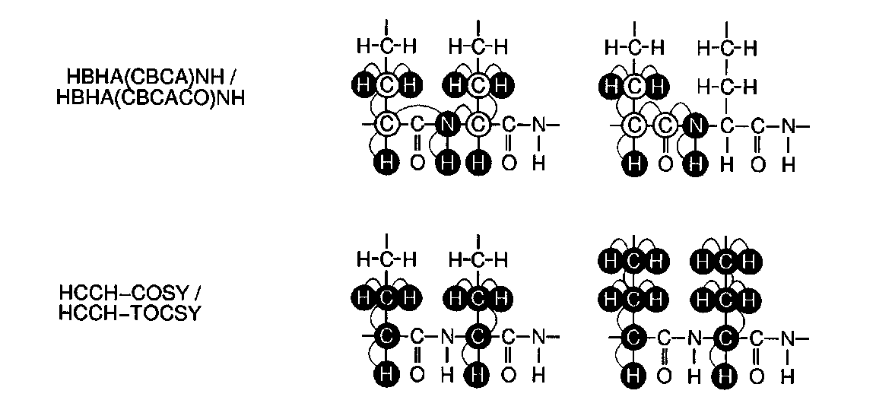
Heteronuclear Side Chain Experiments
Multiple redundancies increase reliability

Slide 33
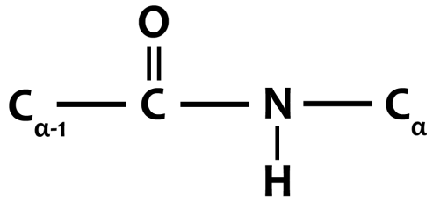
Basic Strategy to Assign Resonances in a Protein
Identify resonances for each residue (scalar)
Put residues in order
T
L
S
R
G
S
G
1 2 3 4 5 6 7
R - G - S - T - L - G - S
Need a coupling to
cross the carbonyl!

Slide 34
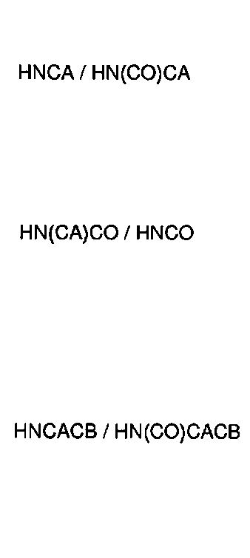
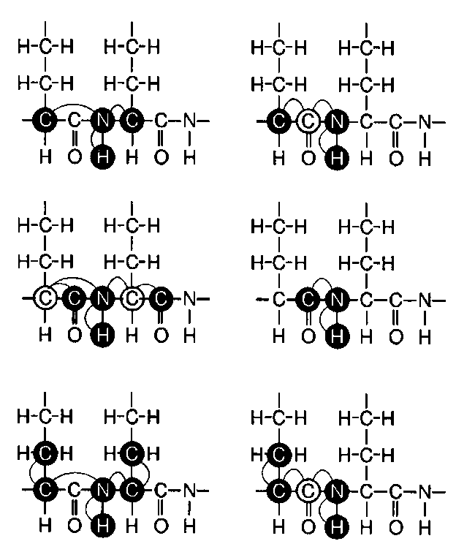
Heteronuclear Triple-Resonance Backbone Experiments
Names of scalar experiments based on atoms detected

Slide 35
Pairs of Experiments Distinguishes Intra-residue from Inter-residue
H
H
H
H
H-C-H
H-C-H
H-C-H
H-C-H
-N-C_{α}-CO-N-C_{α}-CO-
-N-C_{α}-CO-N-C_{α}-CO-
H
H
H
H
H
H
H
H
HNCA
H(t3), N(t2), CA(t1)
2 peaks- Intra + Inter
Mixing from N→Ca occurs over 1 bond to same Ca and over 2 bonds to adjacent Ca
HN(CO)CA
H(t3), N(t2), CA(t1)
1 peak- Inter only
Mixing from N→Ca occurs ONLY over 2 bonds to adjacent Ca

Slide 36
Equivalent Experiments Can be run in either direction
H
H
H
H
H-C-H
H-C-H
H-C-H
H-C-H
-N-C_{a}-CO-N-C_{a}-CO-
-N-C_{a}-CO-N-C_{a}-CO-
H
H
H
H
H
H
H
H
HNCACB
H(t3), N(t2), CA and CB(t1)
Mixing from N→Ca occurs over 1 bond to same Ca and over 2 bonds to adjacent Ca
CBCANH
CB and CA(t1), N(t2), H(t3)
Mixing from N→Ca occurs over 1 bond to same Ca and over 2 bonds to adjacent Ca

