Slide 1
Ubiquitin T₁, T₂, NOE values at 600 MHz
T1
T2
NOE
BMRB 4245, Wand Laboratory

Slide 2
Ubiquitin J(0), J(w_{N}), J(w_{H}) at 600 MHz
J(0)
J(w_{N})
J(w_{H})

Slide 3
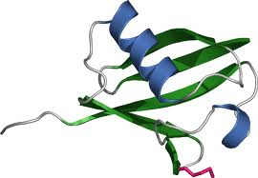
Ubiquitin Diffusion Tensor Analysis
MODEL | Dxx | Dyy | Dzz | Diso | Dratio | tc (ns) | Red. Chi2 | F-statistic | p
isotropic | 3.65 | 3.65 | 3.65 | 3.655E+07 |  | 4.56 | 6.37
axial | 3.41 | 3.41 | 4.02 | 3.615E+07 | 1.18 | 4.61 | 4.02 | 10.2 | 3.24E-05
anisotropic | 3.27 | 3.58 | 4.02 | 3.623E+07 |  | 4.60 | 3.15 | 7.1 | 0.002
Dpar
Dper

Slide 4
Ubiquitin Model-Free Analysis
S²
τ_{e}
R_{ex}

Slide 5
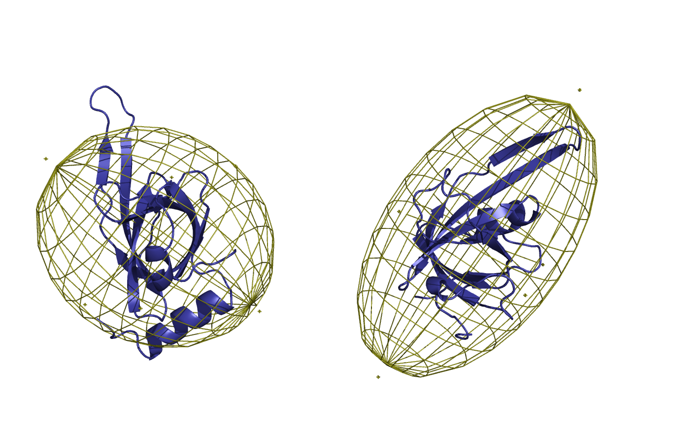
RPA70AB DNA Binding
RPA70AB
70B
70A
70B
70A

Slide 6
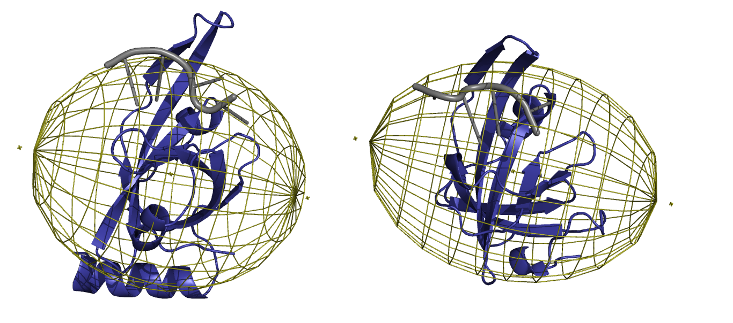
RPA70AB DNA Binding
RPA70AB + dT10
70B
70A
70B
70A

Slide 7
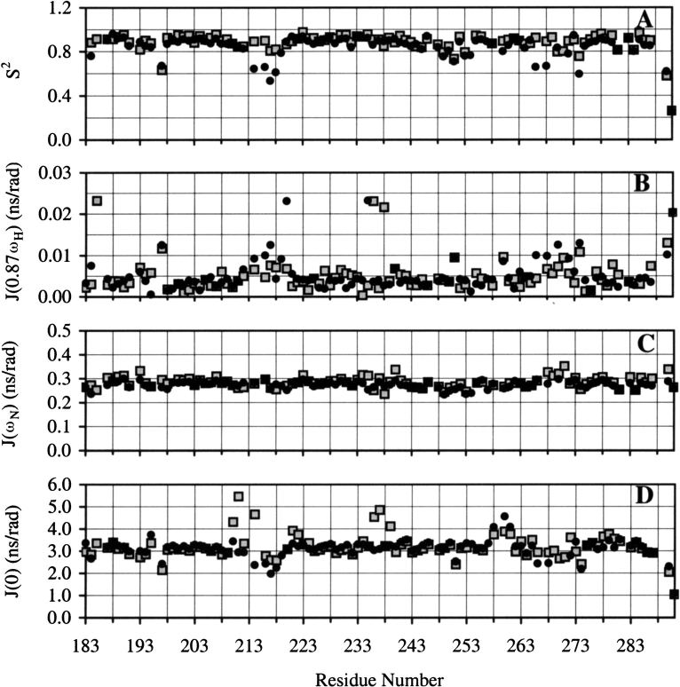
RPA70A DNA Binding
S²
J(w_{H})
J(w_{N})
J(0)

Slide 8
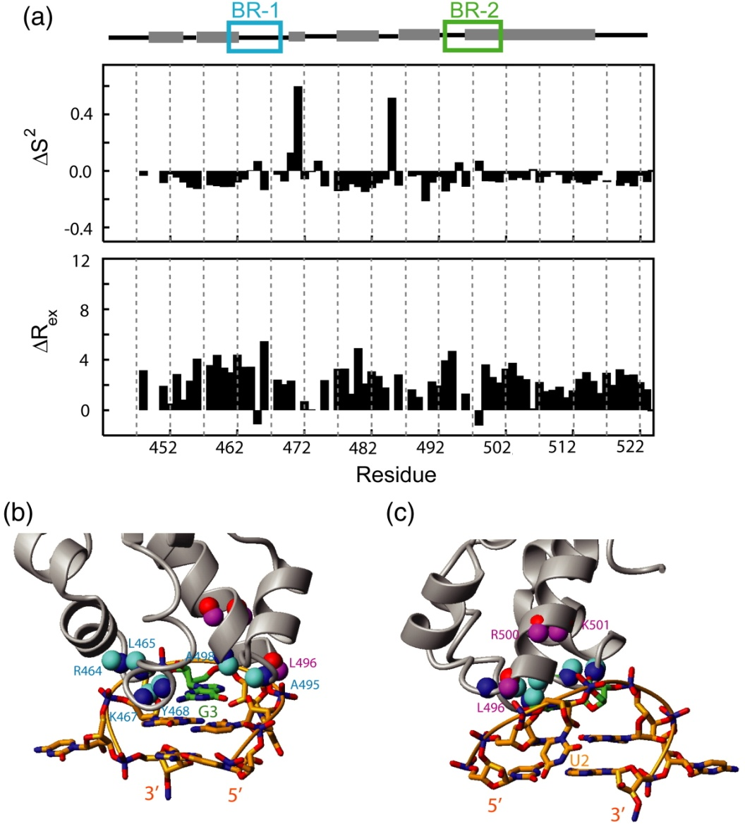
Binding interface between SAM domain and SRE-RNA
Ravindranathan et al, JMB, 2010

Slide 9
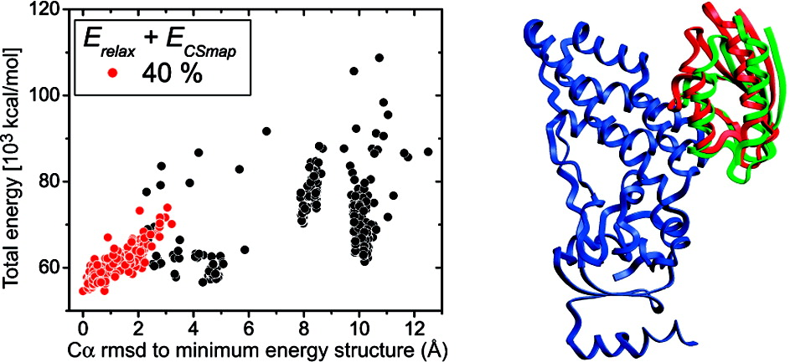
Structural or Docking Restraints
Ryabov, JACS, 2010

Slide 10
The Future
Other relaxation experiments -- relaxation dispersion experiments
Relaxation from multiple nuclei (CO, CH3)
Dynamics from other NMR observables -- RDCs
Integration with other dynamic and structural methods (RDCs, MD, IMP, etc.)

