Slide 1
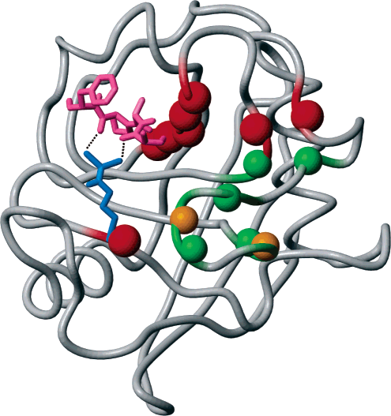
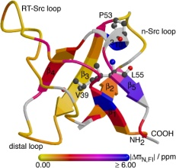
Why study dynamics?
Catalytic Turnover
Signaling/Regulation
?
ΔG, ΔS, ΔH
Thermodynamics – entropy and heat capacity
Protein folding pathways and intermediates
Kleckner & Foster, BBA - Proteins and Proteomics, 2010

Slide 2
Typical Protein Motions and Timescales
10³
10⁰
10⁻³
10⁻⁶
10⁻⁹
10⁻¹²
ks
s
ms
us
ns
ps
Global unfolding
Local unfolding
Overall Tumbling
NH librations/ vibrations
Chemical kinetics
Slow loop reorientation
Fast loop reorientation
Motions

Slide 3
Local Motions – Model-free Formalism
Order parameter (S²)
Describes the amplitude of NH bond motion or the spatial restriction of the NH bond. Ranges in value from 0 to 1.
H
S² low
N
1.0
S²
H
N
0.0
Residue
S² high

Slide 4
Local Motions – Model-free Formalism
Internal correlation time (τ_{e})
Describes the characteristic time it takes the NH bond to explore the space available to it. Can range from 30-400 ps.
H
S² low, τ_{e} long
N
S²
H
t_{e}
N
Residue
S² high τ_{e} short

